Slide 1
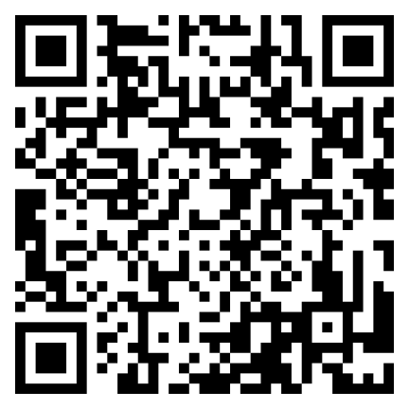
You’re Dismissed: Considerations When Ending the Provider/Patient Relationship
Jenna Misiti, Esq, MHA, CHC
Appalachian Healthcare Legal Consulting, PLLC
*The information in this presentation does not, and is not intended to, constitute legal advice and is for general informational purposes only.
Attendees should contact their attorney to obtain advice with respect to any particular legal matter.

Slide 2
Learning Objectives
Learn about legal, contractual, and medical issues that can arise when terminating a provider/patient relationship.
Become familiar with common patient termination scenarios and learn how to best navigate them.
Review tips for crafting patient termination letters that can help minimize risk to the provider, patient, and organization.

Slide 3
Why Terminate Patients from Care?
Rude or disruptive behavior
Threatening or aggressive behavior or a crime on premises
Continued failure to keep appointments
Refusing to adhere to practice policy (non-smoking policy or controlled substance agreement)
Refusal to follow treatment plan; treatment non-compliance
Refusal to pay (tricky one and not recommended; try to reach out with ways patient can take care of balance or means of assistance)

Slide 4
Potential Legal, Contractual, and Medical Issues

Slide 5
Legal and Ethical Issues
Patient Abandonment
When “without reasonable notice to the patient, a physician unilaterally discontinues treatment at a time when continued medical treatment is necessary.”
Form of medical malpractice.
Requires harm/injury.
Could also lead to licensing board complaint.
Civil Rights Considerations
Because of federal and state civil rights laws a patient cannot be dismissed because of race, ethnicity, religion, sexual orientation, HIV/AIDS status, or gender identity.

Slide 6
Could a Claim be Made for Patient Abandonment?
Provider permanently shuts down office without notice to patients and without making sure there is another source of follow-up care.
Provider does not feel they have the necessary skill to treat a particular ailment, so they refer the patient to another provider.
Patient is continually verbally abusive to staff and is terminated and given 30 days emergency care to locate another provider.
Provider refuses to continue seeing 8-month pregnant patient because of failure to pay bill.
On-call provider forgets to respond to an after-hours call by a patient experiencing chest pain.

Slide 7
Contractual Issues
Issues with language in payor contracts--Medicare, Medicaid, and private health insurance plans may stipulate that certain patients must be accepted and/or specify the steps for dismissing a patient.
Could lead to breach of contract claim.
Review contractual language of major payors in advance to note any limitations.

Slide 8
Medical Issues
Patient is unable to find another provider and suffers an adverse medical event.
Behavioral health issues, such as suicidal ideation or attempts.
Medication issues, such as withdrawal or inability to find another prescriber.

Slide 9
AMA Code of Medical Ethics Opinion 8.115 on Patient-Physician Relationships

Slide 10
Kentucky Board of Medical Licensure
https://kbml.ky.gov/grievances/Documents/Grievance%20FAQ%27s.pdf

Slide 11
Navigating Common Patient Termination Scenarios

Slide 12
Scenario 1
A primary care patient becomes angry during their appointment because they do not agree with the provider’s suggested treatment plan. They lose their temper, pick up the trashcan, throw it against the wall, and storm out of the health center, cussing at the office staff as they go.
What concerns might you have when terminating this patient?

Slide 13
Violent or aggressive patient
Take special care regarding safety when terminating a patient determined to be aggressive or violent.
Consider a certified letter stating they are no longer allowed on property or authorities will be notified. Make staff aware of who the patient is and what the patient looks like.
Depending on the circumstance, consider temporary security or a restraining order.

Slide 14
Scenario 2
A behavioral health patient who is on prescription medication for anxiety and panic disorder has been continuously rude and disrespectful to staff (despite multiple warnings). A decision was made to discharge this patient.
What are some concerns you might have when terminating this patient?

Slide 15
Patient on medication causing withdrawal
If patient is on a medication that can cause serious or life-threatening withdrawal (such as a benzodiazepine), make sure to include appropriate medication refills and/or taper instructions in certified discharge letter.
Also consider whether a patient is in crisis at time of behavior, and whether discharge is currently appropriate.

Slide 16
Scenario 3
A patient is 30 weeks pregnant and has no-showed 3 appointments in a row. These no-call/no-shows are impacting the ability to get other patients scheduled, and the provider would like to send a letter terminating the patient from care.
What concerns might you have?

Slide 17
Pregnant patient
Terminating a patient in late pregnancy is never advisable and could be seen as patient abandonment.
Consider other alternatives such as sending a letter or calling the patient to convey the importance of keeping appointments for her and her baby’s health.

Slide 18
Scenario 4
A patient files a lawsuit against their primary care provider for medical malpractice. A month later, the patient calls to schedule a visit with that same provider.
Is that individual still considered a patient of the provider? How should this be handled?

Slide 19
Patient who has filed lawsuit or complaint
When a patient files a lawsuit or complaint against a health center or provider, this does not automatically terminate the provider/patient relationship.
Take special care and seek legal advice when dealing with dismissal of such a patient. Exact steps will depend on the patient’s specific circumstances.

Slide 20
Scenario 5
A patient has been terminated from the practice. 2 weeks after receipt of the termination letter, results of a recent scan are received by the practice.
What is the provider’s responsibility regarding these results?

Slide 21
Patient results or appointment received post-termination
If results or appointments are received for a previously terminated patient, these cannot be ignored.
Provide the results to the patient in whatever way is necessary (depending on the seriousness of the results) and encourage them to seek continued care in a certified letter.
If you are still in the window for providing emergency care while the patient seeks a new provider, do so.

Slide 22
Communication
Have a standardized process in place.
Counsel the patient first at least once (unless safety risk) and document the conversation in chart.
Insight may be gained as to why the patient is noncompliant and the issue might be fixable.
Make sure the office staff has a way of knowing about the dismissal so the patient is not scheduled after the effective termination date. For example, put an alert on the EMR.

Slide 23
Patient Termination Letter Tips

Slide 24
Termination Letter Tips
Provide the Patient with written notice, preferably by certified mail, return receipt requested as future proof.
Place letter in patient chart.
Provide the patient with a brief explanation for why the relationship is being terminated (for example, noncompliance or threatening behavior). Do not go into detail.
Make clear whether the dismissal is from one provider or the whole practice.
Give sufficient notice. Agree to continue care or offer emergency care for at least 30 days, to allow a patient time to secure the services of another provider.

Slide 25
Termination Letter Tips (cont’d)
Remember to check medication lists to see if it is is necessary to offer refills or a taper to avoid withdrawal or other negative medical consequences.
Check for outstanding referrals.
Provide resources to help the patient locate another physician (for example the state medical association or patient’s insurance company). Do not suggest another facility by name.
Offer to transfer records to the new physician upon receipt of a signed authorization to do so.
Ask—does the patient represent a credible threat to the health center staff or patients?

Slide 26
Sample Letter Language
Due to your [disrespectful treatment of/inappropriate language towards our staff] or [continuous appointment no-shows and noncompliance with treatment], we feel we are no longer able to foster a therapeutic relationship with you as a patient at [name of health center]. Therefore, we are terminating your provider-patient relationships with all [name of health center] providers, effective immediately.

Slide 27
Sample Letter Language
We will provide you with emergency care for the next thirty days, giving you time to locate a new provider. We strongly urge you to make arrangements for the services of another primary care provider as soon as possible to maintain the continuity of your care. We recommend contacting your insurance company or state medical society for assistance in finding a new provider.
Our office is happy to forward your patient records to a new provider of your choice upon receiving an appropriately executed release. A release form has been enclosed with this letter for your convenience.
We appreciate your understanding in this matter and assure you we will do all we can to facilitate a smooth transition in your care.

Slide 28
Sample Letter Language
If the patient commits a crime on premises or demonstrates threatening behavior:
Recently you demonstrated aggressive and threatening behavior towards our staff. Due to your behavior, we are no longer able to see you as a patient. Further, because of safety concerns for our staff, you are no longer allowed on [name of health center] premises, for any reason. If you are seen on [name of health center] property, at any of our health centers, law enforcement officials will be promptly notified.
OR
Due to your recent theft on health center property…

Slide 29
Sample Letter Language
If patient is on medication that could cause withdrawal:
Attached with this letter are important weaning instructions for your [insert medication name] prescription. Following these instructions is critical in order to avoid potential serious symptoms from withdrawal.

Slide 30
Sample Letter Language
If patient needs refills for medication or has a referral outstanding:
You will be informed of the dates and times of any specialty referral appointments once our office receives them. It is your responsibility to keep such appointments.
OR
A two-month supply of your medications has also been called in.

Slide 31
Sample Letter Language
If the patient indicated they were ending the provider/patient relationship, I still recommend memorializing this in writing.
“As you stated during your [date] appointment, it is your wish to no longer continue our provider/patient relationship. Therefore…”

Slide 32
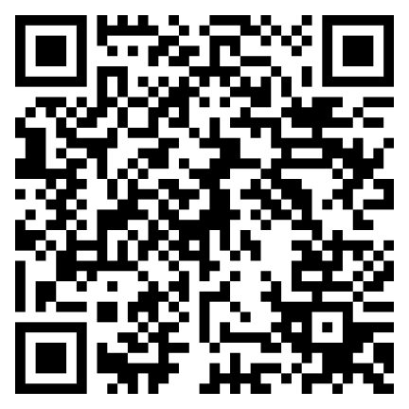
Contact Information
Jenna Misiti, Esq, MHA, CHC
Appalachian Healthcare Legal Consulting, PLLC
Email: Jenna@AHLCWV.com
Website: AHLCWV.com
Phone: (304) 220-0055
Address: 418 8th Street, Suite 302, Huntington, WV 25701

