Slide 1
Perinatal Hep B, Perinatal Hep C and MPox

Slide 2
Perinatal Hepatitis B in Kentucky
Shannon Million, APRN, DNP, PNP-PC and Roberta Butler, RN, MSN
KDPH Perinatal Hepatitis B Coordinators
KPCA Conference
April 12, 2023

Slide 3
Hepatitis B Virus
Infectious liver disease that can be acute or chronic.
90% of infants that are infected with HBV will develop chronic infections and 25% will die prematurely from cirrhosis or liver cancer
HBV is transmissible to infants from infected mother (HBsAg+) during delivery.
https://www.cdc.gov/vaccines/programs/perinatal-hepb/downloads/HepB-Provider-tipsheet-508.pdf

Slide 4
Preventing Transmission
HBsAg screening is required for ALL pregnancies in Kentucky
Infants born to HBsAG + women should receive
HBIG and a dose of single-antigen Hepatitis B vaccine within 12 hours of birth
A complete series of hepatitis B vaccines
Postvaccination serology testing between 9-12 months of age or 1-2 months after vaccine completions series
Completion of the HBIG and Hepatitis B vaccine series is up to 94% effective in preventing perinatal transmission!
https://www.cdc.gov/vaccines/programs/perinatal-hepb/downloads/HepB-Provider-tipsheet-508.pdf

Slide 5
Your Role as a Primary Care Provider
Identifying infants in your practice that have been exposed
Educating parent on importance of series completion with PVST testing to confirm immunity
Completing Hepatitis B vaccine series
Ensuring that postvaccination serologic testing (PVST) is completed

Slide 6
Perinatal Hepatitis B in Kentucky
For the 2021 birth cohort 84 infants were reported and followed by the Perinatal Hepatitis B Prevention Program.
CDC estimates that our numbers are more likely between 100-200 cases per year.
Of the 84 infants, 67 completed the HBIG and Hepatitis B vaccine series by 12 months of age.
Of the 67 completing the series, ONLY 21 received their PVST confirming immunity. 20 of the 21 were confirmed to be immune.

Slide 7
Notes:
Mother is HBsAg-unknown If other evidence suggestive of maternal hepatitis B infection exists (e.g., presence of HBV DNA, HBeAg-positive, or mother known to have chronic hepatitis B infection), manage infant as if mother is HBsAg-positive
Birth dose (monovalent HepB vaccine only):
Birth weight ≥2,000 grams: administer HepB vaccine within 12 hours of birth. Determine mother’s HBsAg status as soon as possible. If mother is determined to be HBsAg-positive, administer HBIG as soon as possible (in separate limb), but no later than 7 days of age.
Birth weight <2,000 grams: administer HepB vaccine and HBIG (in separate limbs) within 12 hours of birth. Administer 3 additional doses of HepB vaccine beginning at age 1 month (total of 4 doses)
Final (3rd or 4th) dose: administer at age 6 months (minimum age 24 weeks)
If mother is determined to be HBsAg-positive or if status remains unknown, test for HBsAg and anti-HBs at age 9–12 months. If HepB series is delayed, test 1–2 months after final dose. Do not test before age 9 months.

Slide 8
Management of Infants Born to Women with HBV Infection

Slide 9
HELP!
My practice has identified a perinatally HBV-exposed newborn that did not receive HBIG in hospital! Now what?
If the infant is under 7 days old, the HBIG can still be administered and an urgent referral will be needed!
If the infant is over 7 days old, HBIG will be unlikely to prevent transmission-however infant should still complete routine HepB vaccination series with PVST testing as recommended!

Slide 10
PVST
Required for all infants born to women with HBV infection
Serologic testing will confirm if child is immune of has been infected
Testing should occur between 9-12 months of age OR 1-2 months after vaccine series completion
ONLY LABS TO BE COLLECTED
Hepatitis B surface antigen (HBsAg) AND
Hepatitis B surface antibody (anti-HBs)
DO NOT ORDER tests for antibodies to HB core antigen (anti-HBc)
https://www.cdc.gov/vaccines/programs/perinatal-hepb/downloads/HepB-Provider-tipsheet-508.pdf

Slide 11
Serology Interpretation

Slide 12
PVST Common Questions
Why between 9-12 months of age?
Testing too early can provide inaccurate results by detecting passive antibodies from HBIG administered at birth rather than the actual response to the HepB vaccine
How soon can I perform PVST testing after series completion?
Testing must be conducted at 9-12 months of age OR 1-2 months after vaccine series completion. Transient positivity can be present for 18 days after vaccination.
How late can I perform PVST?
Delaying can cause a negative/non-reactive anti-HBS result which will make it difficult to determine immune status. For this reason, testing should be done in the recommended time frames.
https://www.cdc.gov/vaccines/programs/perinatal-hepb/downloads/HepB-Provider-tipsheet-508.pdf

Slide 13
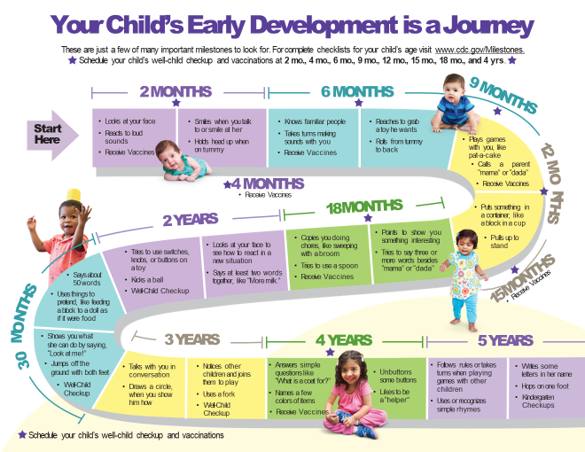

Slide 14
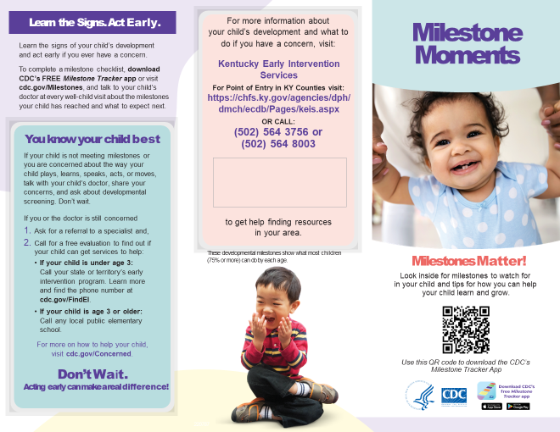

Slide 15
Contacts
Perinatal Hepatitis B Prevention Program Coordinators for Kentucky:
Shannon Million
Shannon.million@ky.gov
Roberta Butler
Roberta.butler@ky.gov
Perinatal Hepatitis B Coordinator List | CDC

Slide 16
Perinatal Hepatitis C in Kentucky
Dia J Obonyo, DrPH
KDPH Viral Hepatitis Program
KPCA Conference
April 12, 2023

Slide 17
Rates of Acute Hepatitis C Per 100,000
*

Slide 18
Notes:
In 2006, baby boomers were 42-60 years old
By 2018, we see a bimodal distribution, where there are two peaks.

Slide 19
Demographic Information for Acute Hepatitis C Cases
Case Count by Patient Current Gender and Age Group, Kentucky 2015-2021
Notes:
Some other basic data for acute cases…In Kentucky, the 30-39 reports the highest incidence, 20-29 is not far behind. The pop for new cases is young.

Slide 20
Demographic Information for Acute Hepatitis C Cases
Notes:
These are the acute cases by reported gender and age group.
The gender gap is closest among 20-29 year olds.

Slide 21
Office of Vital Statistics Birth Certificate Data, Kentucky 2010-2020
Notes:
From our birth certificate data, we see the count and rates of mothers with HCV giving birth have steadily risen over time.

Slide 22
Perinatal Case Reports Received by KDPH
Risk Factors of Mothers or Pregnant Women | Yes | No/Unknown | % with Risk Factor
Intravenous Drug Use | 1448 | 975 | 33.6
Multiple Sex Partners | 247 | 1469 | 5.7
STIs | 210 | 1472 | 4.9
HIV | 9 | 1559 | 0.2
Exposure to Known Hepatitis Positive Contact | 243 | 1328 | 5.6
Incarceration | 187 | 1357 | 4.3
Intransasal Drug Use | 91 | 1436 | 2.1
n=4,306
Notes:
In our perinatal cases, among data we have available, Injection drug use is the highest reported risk factor.

Slide 23
Children with HCV in Kentucky
???
2020:
(1,030 births from women with HCV) 5-7% = 51.5-72.1
2021:
(1,156 births from women with HCV) 5-7% = 57.8-80.92
Jan to mid-March 2022:
(230 births from women with HCV) 5-7% = 11.5-16.1
Notes:
Likely all undercounts
5-6 cases every month

Slide 24
Table 3.4 Number of newly reported cases* of perinatal hepatitis C virus infection, by state or jurisdiction United States, 2020
State or Jurisdiction | Perinatal Hepatitis C
Alabama | —
Alaska | —
Arizona | —
Arkansas | 1
California | 7
Colorado | 3
Connecticut | 1
Delaware | 1
District of Columbia | —
Florida | 5
Georgia | 2
Hawaii | —
Idaho | —
Illinois | 5
Indiana | 16
Iowa | —
Kansas | —
Kentucky | —
State or Jurisdiction | Perinatal Hepatitis C
Louisiana | 2
Maine | 7
Maryland | 1
Massachusetts | 3
Michigan | 9
Minnesota | 5
Mississippi | —
Missouri | —
Montana | —
Nebraska | —
Nevada | 3
New Hampshire | —
New Jersey | 8
New Mexico | —
New York | 2
North Carolina | —
North Dakota | —
Ohio | 38
State or Jurisdiction | Perinatal Hepatitis C
Oklahoma | —
Oregon | 2
Pennsylvania | 17
Rhode Island | U
South Carolina | —
South Dakota | —
Tennessee | 9
Texas | N
Utah | —
Vermont | —
Virginia | 5
Washington | 5
West Virginia | —
Wisconsin | 8
Wyoming | —
Total | 165
U: Unavailable. The data were unavailable.
Source: CDC, National Notifiable Diseases Surveillance System.
Centers for Disease Control and Prevention. Viral Hepatitis Surveillance Report – United States, 2020. https://www.cdc.gov/hepatitis/statistics/2020surveillance/index.htm. Published September 2022.
* Reported confirmed cases. For case definition, see https://ndc.services.cdc.gov/conditions/hepatitis-c-perinatal-infection/.
—: No reported cases. The reporting jurisdiction did not submit any cases to CDC.
N: Not reportable. The disease or condition was not reportable by law, statue, or regulation in the reporting jurisdiction.
Notes:
If you think it’s strange to not have this data, it’s not uncommon…
The data for perinatal HCV throughout the country are very limited.
https://www.cdc.gov/hepatitis/statistics/2020surveillance/hepatitis-c/table-3.4.htm

Slide 25
CDC Guidelines during Pregnancy
Recommendation as of April 2020: providers test all pregnant patients for hepatitis C during each pregnancy.
Kentucky began requiring this in 2018
Currently, there are no hepatitis C treatments approved for use during pregnancy (although many promising trials are ongoing)
There are no preventive measures available that can reduce the risk of passing the virus on to the baby
Notes:
https://www.acog.org/womens-health/faqs/hepatitis-b-and-hepatitis-c-in-pregnancy#:~:text=Currently%2C%20there%20are%20no%20hepatitis,make%20sure%20you%20stay%20healthy.

Slide 26
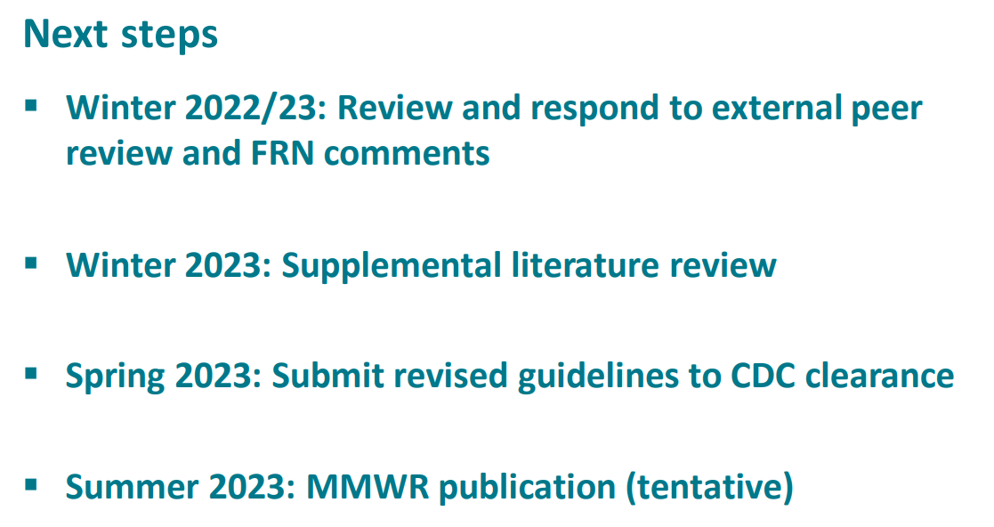
CDC Perinatal HCV testing recommendations
In process of updating recommendations NOW

Slide 27
Current (soon-to-be old) CDC Perinatal HCV testing recommendations
Current guidelines recommends testing at 18 months
Many exposed children are lost to follow-up by 18 months
Testing sooner is thought to better engage caregiver/child and lead to better follow-up
Notes:
Rationale for changing is…
https://www.cdc.gov/hepatitis/policy/pdfs/CDC_perinatal_hep_c_testing_508.pdf

Slide 28
https://www.cdc.gov/hepatitis/policy/pdfs/CDC_perinatal_hep_c_testing_508.pdf

Slide 29
https://www.cdc.gov/hepatitis/policy/pdfs/CDC_perinatal_hep_c_testing_508.pdf
Notes:
Work group looked at 20 years of data
Performed cost-effectiveness analysis

Slide 30
https://www.cdc.gov/hepatitis/policy/pdfs/CDC_perinatal_hep_c_testing_508.pdf

Slide 31
https://www.cdc.gov/hepatitis/policy/pdfs/CDC_perinatal_hep_c_testing_508.pdf

Slide 32
New Testing Guidelines for Perinatally Exposed Children (expected to be published Summer 2023)
Perinatally exposed infants should receive a NAT for HCV RNA at age 2-6 months to identify children who might go on to develop chronic HCV infection
Additionally:
Infants and children aged 7-17 months who are perinatally exposed to HCV and have not previously been tested should receive a NAT for HCV RNA
Children aged ≥ 18 months who are perinatally exposed to HCV and have not previously been tested should receive an anti-HCV test with reflex* to NAT for HCV RNA
https://www.cdc.gov/hepatitis/policy/pdfs/CDC_perinatal_hep_c_testing_508.pdf
Notes:
Pre-public comment period.
It’s possible the final language will differ.

Slide 33
Kentucky HCV Reporting Regulations
Currently, per Kentucky Administrative Regulation (KAR) for Reportable Disease Surveillance, 902 KAR 2:020, the following hepatitis C-related conditions must be reported as follows:
Section 7. Notification of the following diseases shall be considered routine and shall be made within five (5) business days: (5) Hepatitis C, acute; (6) Hepatitis C infection in a pregnant woman; (7) Hepatitis C infection in an infant or a child aged five (5) years or less; (8) Newborns born to Hepatitis C positive mothers at the time of delivery

Slide 34
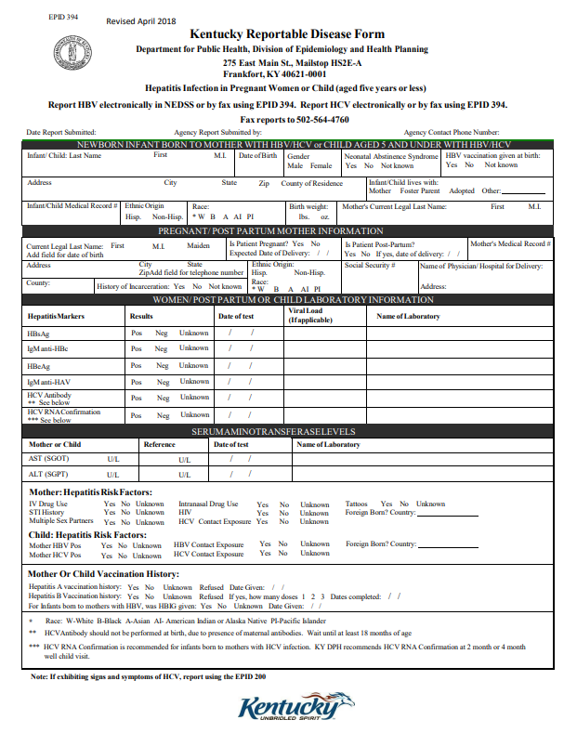
EPID 394 Hepatitis Infection in Pregnant Women or Child (aged five years or less)
Fill out and email to vhp@ky.gov
Or Fax to: 502-564-4760
*We hope to have an electronic option in the near future*
Fillable pdf available at https://www.chfs.ky.gov/agencies/dph/dehp/idb/Documents/EPID394HepPregnantWomenorChild.pdf
Notes:
EPID 394, Kentucky Reportable Disease Form, Hepatitis Infection in Pregnant Women or Child (aged five (5) years or less);

Slide 35
Treating HCV in Children
Direct-acting antiviral (DAA) treatment with an approved regimen is recommended for all children and adolescents with HCV infection aged ≥3 years as they will benefit from antiviral therapy, regardless of disease severity.
Clinical trial data evaluating DAA regimens in children and adolescents have allowed expanded use of these safe, well-tolerated, efficacious HCV therapies in the pediatric population.
https://www.hcvguidelines.org/unique-populations/children

Slide 36
Kentucky's Hepatitis C Elimination Plan
Released August 2022
First ever statewide HCV elimination strategy
Kentucky Hepatitis C Elimination Plan:
HepatitisCEliminationPlan.pdf (ky.gov)
https://chfs.ky.gov/agencies/dph/dehp/idb/Documents/HepatitisCEliminationPlan.pdf
KY HCV Elimination Plan

Slide 38
Priority Populations
After review, these priority populations were specifically named in the plan
People who use drugs (PWUD)
Incarcerated individuals
Historically excluded racial and ethnic populations
Baby boomers
Pregnant/parenting persons
Children in foster care
People with prior HCV infection
Rural communities

Slide 39
Current Priorities/Major Elimination Projects:
IMPLEMENTATION
Medicaid Policy: Prior Authorization; Re-treatment restrictions
Corrections: state and local level strategies
HCV Outbreak Response Planning
Build/enhance perinatal efforts
Surveillance Improvement

Slide 40
https://kyrha.org/khamp
Goal: Increase the number of people with hepatitis C infection linked to care and CURED in high-risk, low resource settings
Free training and mentoring program for healthcare providers:
Education on Hepatitis C Virus, epidemiology, diagnosis, management, treatment, prevention and after cure planning

Slide 41
Contacts
KY HCV Elimination Plan
KDPH Viral Hepatitis Program Staff:
Dia Obonyo dia.obonyo@ky.gov
Claire Holladay claire.holladay@ky.gov
Jordan Murphy Jordan.murphy@ky.gov
Viral Hepatitis Program email: vhp@ky.gov
Data request link: https://redcap.chfs.ky.gov/surveys/?s=T3E3448XKW3J4JE9
​
KDPH Viral Hepatitis Program Website:
Viral Hepatitis Program - Cabinet for Health and Family Services (ky.gov)
https://chfs.ky.gov/agencies/dph/dehp/idb/Pages/vhp.aspx

Slide 42
Mpox Update
Amy Herrington, DNP, RN, CEN, CNE
2023

Slide 43
Reported Cases

Slide 44
Weekly Data

Slide 47
Mpox Resources
Mpox website
https://www.chfs.ky.gov/agencies/dph/dehp/idb/Pages/monkeypox.aspx
Disease information
Testing recommendations
Treatment options
Vaccination information

Slide 48
Vaccination

Slide 49
Vaccination Locations

Slide 50
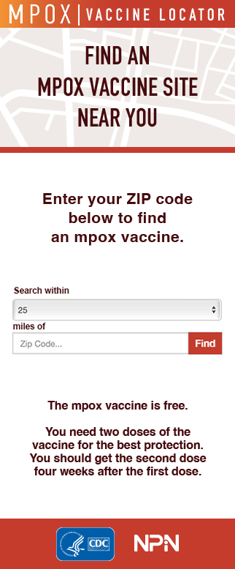
Mpox Vaccine Locations

Slide 51
Post Test Questions

