Slide 1
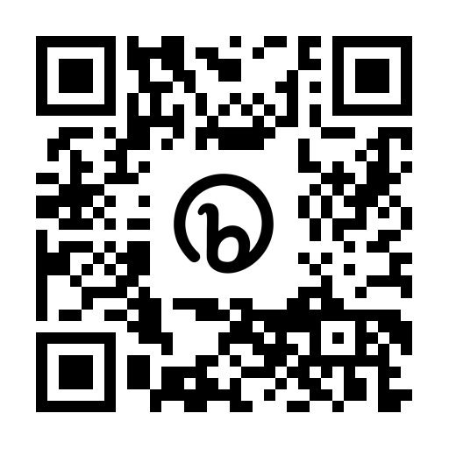
GRANTS:
FUNDING RESOURCES, WRITING, & MANAGEMENT

Slide 2
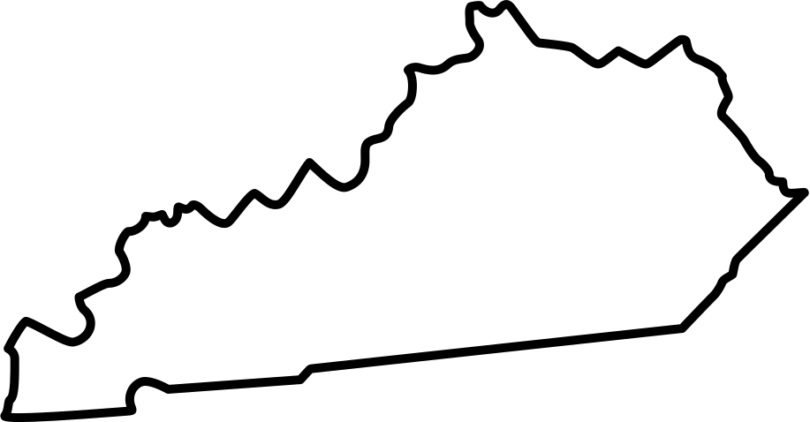
ABOUT US
THE UK CENTER OF EXCELLENCE IN RURAL HEALTH SERVES AS THE FEDERALLY-DESIGNATED KENTUCKY OFFICE OF RURAL HEALTH. LOCATED IN HAZARD, KENTUCKY, THE KORH ASSISTS CLINICIANS, ADMINISTRATORS, AND CONSUMERS IN FINDING WAYS TO IMPROVE COMMUNICATIONS, FINANCES AND ACCESS TO QUALITY HEALTH CARE

Slide 3
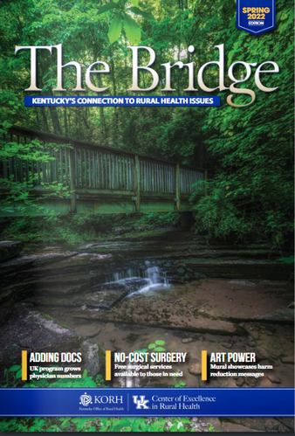
WHAT IS KORH?
Resources
Rural Voice
THE PROGRAM PROVIDES A FRAMEWORK FOR LINKING SMALL RURAL COMMUNITIES WITH LOCAL, STATE, AND FEDERAL RESOURCES WHILE WORKING TOWARD LONG-TERM SOLUTIONS TO RURAL HEALTH ISSUES.
ENSURES THAT FUNDING AGENCIES AND POLICYMAKERS ARE MADE AWARE OF THE NEEDS OF RURAL COMMUNITIES.

Slide 4
QUICK POLL
GETTING TO KNOW THE GROUP

Slide 5
Grants...
1
FINDING FUNDING
Take a look at local resources that provide funding and where to look to find grants.
2
GRANT WRITING
Quick tips and tricks from a HRSA grant reviewer.
3
GRANT MANAGEMENT
Management tips and group discussion.

Slide 6
1
FINDING RESOURCES
WHERE ELSE CAN YOU FIND FUNDING FOR PROJECTS?

Slide 7
Funding Resources
KORH Resources - Weekly Update & Finding Funding in Kentucky
Rural Health Information Hub (RHIhub)
Philanthropy News Digest
Grants.gov
Paid Services - Candid, GrantStation, Pivot RP, etc

Slide 8
Finding Funders
Community Foundations
DAFs, Matching Funds, Fundraising, Disaster funding
Kentucky Funders
Corporate funders, private foundations, regional foundations
Government Funders
Quasi-government, USDA Rural Partners Network
Academic Funding
Often Research-based

Slide 9
2
GRANT WRITING
BEING GRANT READY AND A FEW WRITING TIPS.

Slide 10
ARE YOU
GRANT READY?
1
Agency Mission Statement
Certificate of incorporation as a non-profit organization - needed to submit with proposal
2
Most recent overall organization budget and individual program budgets.
Most recent 501(c)(3) letter or other proof of tax exempt status
9
3
Employer identification number & DUNS number - Required for all federal applications. May take time.
Job descriptions for all positions - Don't forget to update as you add positions.
4
10
Annual Report - Do you have one?
List of all current funding sources and potential sources of matching funds.
5
11
Organization Chart and list of board members
6
Personnel policies and procedures, updated floor plan, disaster plan
Any recent needs assessments, program evaluation reports, and examples of forms being used
12
7
Boilerplate - a paragraph or two about when and how the organization started and significant milestones.
Current resumes and "biographies" (biosketches) of key staff
13
8

Slide 11
STRAIGHT FROM THE HRSA (REVIEWER'S) MOUTH
BIGGER PICTURE
SCORING
Be descriptive about your population & geography.
What makes the area unique - both assets and needs.
Assume the reviewer knows nothing.
Use visual cues and formatting to emphasize.
Every federal proposal is very specific about scoring.
Reviewers have small ranges to pick from that are very descriptive.
Scoring Criteria is included at the end of the NOFO - use it.
Things such as grammar, headings, order - do not impact your score.

Slide 12
3
GRANT MANAGEMENT
LET'S DISCUSS YOUR MANAGEMENT

Slide 13
MANAGEMENT THOUGHTS
RELATIONSHIPS ARE KEY
DO YOU HAVE A BACK UP FOR THE BACK UP?
Who's managing your grant?
How are you tracking your grant?

Slide 14
OTHER RESOURCES
Grant Ready Kentucky
One-on-One Sessions with Grant Pro
RHIhub
Data, Funding Opportunities, Events
KY Grant Resources - Partnership for Grant Resources
Instrumentl = $ ☹

Slide 15
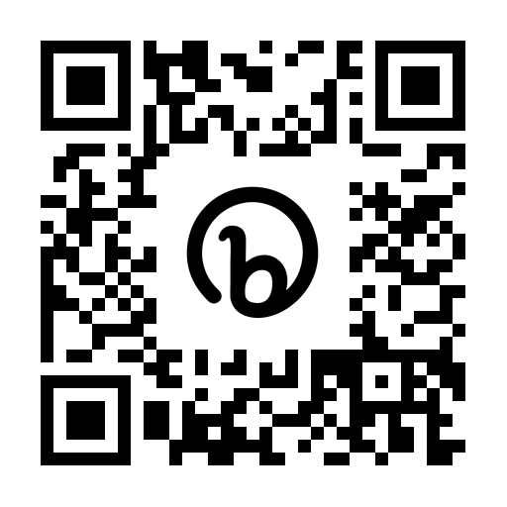
CONNECT W/ US!
606-439-3557
matt.coleman@uky.edu
Don't forget to sign up for our contact lists!

