Slide 2
AGENDA
Legislative Updates
Consolidated Appropriations Act, 2023
Telehealth Policy
RHC Burden Reduction Act
Regulatory Updates
CMS Policy Regarding RHC Rurality Requirements
2023 Medicare Physician Fee Schedule
Public Health Emergency (PHE) ending May 11th

Slide 3
LEGISLATIVE UPDATES
Signed into law:
Consolidated Appropriations Act of 2023
Introduced:
RHC Burden Reduction Act ~ S. 198
Ongoing:
Telehealth Policy

Slide 4
CONSOLIDATED APPROPRIATIONS ACT OF 2023
Expanded Medicare coverage to include Marriage and Family Therapists (MFTs) and Mental Health Counselors – beginning January 1, 2024.
Waived 4% “pay as you go” or PAYGO Medicare reduction (for two years) which was previously set to kick in January 1, 2023.
Extended several Medicare telehealth provisions.. More on this later!
Grant programs for which RHCs are eligible entities
Created “intensive outpatient services” treatment category of which RHCs are eligible providers under a special payment rule – beginning January 1, 2024
Intensive Outpatient Service is a level of care below partial hospitalization requiring between 9 and 20 hours of treatment per week.

Slide 5
BIDEN BUDGET REQUEST FY 2024
Rural Behavioral Health Initiative
“Rural areas represent nearly 60 percent of Mental Health Professional Shortage Areas, encompassing more than 25 million people who do not have adequate access to mental healthcare providers. Rural health clinics serve as a key access point for healthcare service where there is no Federally Qualified Health Center. The budget for rural health includes $10 million for a new Rural Health Clinic Behavioral Health Initiative to expand access to mental health services in rural communities.”

Slide 6
TELEHEALTH POLICY

Slide 7
Consolidated Appropriations Act, 2023
De-links Medicare telehealth policies from PHE+151-day existing policy, including G2025 policy for RHCs
RHCs can continue to be distant site providers through December 31, 2024 (at least)
Paid $98.27 for all services on Medicare’s telehealth list (200+ codes)

Slide 8
Mental Health via Telehealth
Permanent coverage in the RHC setting, reimbursed at All-Inclusive Rate, counted as a visit
In-person requirements are waived until January 1, 2025
After this period, beneficiaries must have an in-person visit within 6 months of furnishing mental health via telehealth service and an in-person service must be provided at least every 12 months thereafter.
Some exceptions may be made based on patient need

Slide 9
CURRENT MEDICARE TELEHEALTH BILLING POLICIES
Name of Telehealth Service | Brief Description | How to Bill | Amount (2023)
Virtual Check-In or Virtual Care Communications | Remote evaluation – G2010 Brief communication with patient (5 min) – G2012 | G0071 No modifier necessary Rev Code 052X | $23.72
Chronic Care Management | 99484, 99487, 99490, 99491, 99424, and 99425 = G0511 99492, 99493 = G0512 | G0511 – Care Management G0512 – Psychiatric Care Management | G0511 - $77.94 G0512 - $146.73
Digital e-visits | Online digital evaluation and management 99421-99423 | G0071 No modifier Rev Code 052X | $23.72
Telehealth Visits | One to one substitutes for in-person services/visits List of allowable services maintained by CMS | G2025 Modifier 95 optional Modifier CS (for services where cost sharing is waived) Rev Code 052X Costs and encounters carved out of cost report | $98.27
Mental Health Telehealth Visits | CPT Codes that can be billed with 0900 revenue code | Rev Code 0900 Use proper mental health CPT code Modifier CG always Modifier 95 if audio-video Modifier FQ if audio-only Count costs and encounters on cost report | All-Inclusive Rate
Telehealth Services
but not considered a telehealth “visit”

Slide 10
MEDPAC STUDY DUE JUNE 2023
Consolidated Appropriations Act of 2022 directed MedPAC to analyze telehealth policy
The legislation mandates that the study analyze:
“The utilization of telehealth services under the Medicare program…
Medicare program expenditures…
Medicare payment policy for telehealth services and alternative approaches to such payment policy, including for federally qualified health centers and rural health clinics.”
|
|
NARHC.org

Slide 11
TELEHEALTH GOOD NEWS/BAD NEWS
GOOD NEWS
Several pieces of legislation will achieve our policy priority (normal coding, normal reimbursement, etc.)
It is the industry expectation that Congress will continue coverage of telehealth
BAD NEWS
Unlikely to get much movement on any telehealth legislation until we are close to “telehealth cliff” at the end of 2024
Probable that Congress will pass more temporary extensions, not permanent policy

Slide 12
RHC Burden Reduction Act (S.198)
Would align RHC physician supervision requirements with state scope of practice laws governing Nurse Practitioners and Physician Associates
26 states have granted NPs full practice authority, yet NPs practicing in RHCs in those states still have federal supervision requirements
Would allow RHCs to satisfy onsite laboratory requirements if they provide “prompt access” to the required lab services
CMS would be directed to define “prompt access”
Would allow RHCs to employ or contract with their NPs and PAs
Currently one NP/PA must be formally employed, as referenced by a W-2
Would fix “urbanized area” issue in the statute
Would allow RHCs to provide over 49% behavioral health services, if they are located in a mental health-Health Professional Shortage Area (HPSA)
*Bill has been introduced in the Senate, there is currently no House companion bill.*

Slide 13
How can you effectively advocate?

Slide 14
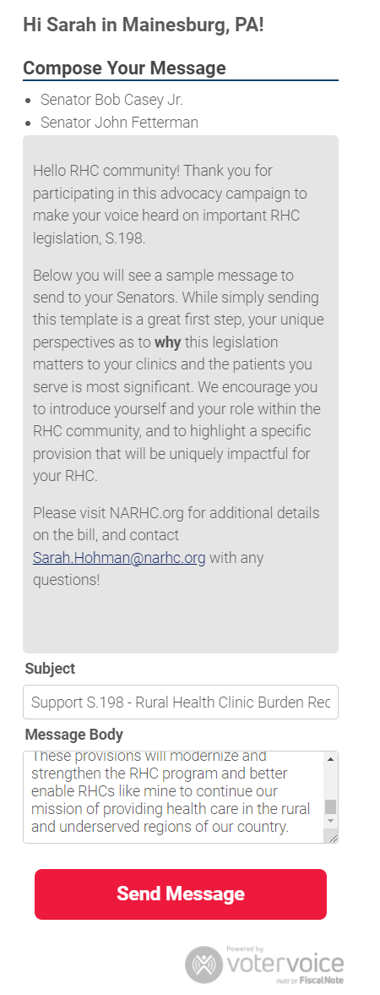
Options:
Just click “send message,” or, even better….
Personalize the message
This legislation came from the RHC community and will impact the RHC community
Introduce your RHC and the patients/community you serve
Pick a provision with implications for your clinic and write one sentence as to why it’s important

Slide 15
REGULATORY UPDATES
Census Bureau Definition Change & Its Implications
2023 Medicare Physician Fee Schedule
Public Health Emergency (PHE) ending May 11th
CMS Delays Phase II of Good Faith Estimate Policy
2024 Medicare Physician Fee Schedule

Slide 16
CMS Interim Policy – RHC Rurality
RHCs have always been eligible to be located in an area that is “not an urbanized area” as defined by the Census Bureau
With the 2020 maps, the Census Bureau stopped defining “urbanized area”
NARHC escalated the issue with CMS and Members of Congress in the absence of a policy
Policy (essentially maintaining status quo) was released March 31

Slide 17
2023 Physician Fee Schedule FINAL RULE
Clarified for grandfathered RHCs that their cap would be based on the most recent cost report that represents a full 12 consecutive months
New care management codes (beginning January 1, 2023) “General Behavioral Health Integration” and “Chronic Pain Management”
Billed through G0511 but Chronic Pain Management G3002 could also be billed as an encounter with modifier CG

Slide 18
Public Health Emergency Ends on May 11th, 2023

Slide 19
National Emergency Versus Public Health Emergency
COVID-19 National Emergency (Section 201 of the National Emergencies Act)
Declared by the President; initially declared on March 13, 2020 and extended twice since
House and Senate recently voted to immediately end the national emergency; President Biden expected to sign
Public Health Emergency (PHE) (Section 319 of the Public Health Service Act)
Declared by Secretary of Health and Human Services (HHS); initially declared on January 27, 2020 and renewed every 90 days since
Expiring May 11, 2023

Slide 20
What is concluding immediately after the COVID-19 Public Health Emergency expires?
RHC Specific Waivers - CMS
Certain Staffing Requirements 2 CFR 491.8(a)(6)
CMS waived the requirement that a NP, PA, or CNM be available to furnish patient care services at least 50% of the time the RHC is operating.
Temporary Expansion Locations 42 CFR §491.5(a)(3)(iii)
CMS waived the requirement that RHCs be separately considered for Medicare survey and certification if services were expanded into more than one permanent location, including areas that would not typically meet RHC location requirements.
Bed Count for Provider-Based RHCs
CMS permitted provider-based RHCs subject to their clinic-specific, grandfathered upper-payment limit to increase their hospital bed count over 50 without losing their grandfathered status.

Slide 21
What is concluding immediately after the COVID-19 Public Health Emergency expires?
RHC Specific Waivers Continued
Home Nursing Visits
CMS removed the requirement that RHCs in an area without a current home health area shortage needed a written request and justification in order to provide home nursing services.
Virtual Communication Services
CMS allowed for online digital evaluation and management services (99421, 99422, and 99423) to be reimbursed under G0071.
After the PHE, G0071 should only be used for G2012 and G2010.

Slide 22
Other waivers concluding immediately after the COVID-19 PHE expires:
HIPAA Notification of Enforcement Discretion - HHS Office for Civil Rights (OCR)
“OCR will exercise its enforcement discretion and will not impose penalties on covered health care providers for noncompliance with the requirements of the HIPAA Rules in connection with the good faith provision of telehealth using non-public facing audio or video remote communication technologies {Zoom, Facebook Messenger, Skype, FaceTime} during the COVID-19 PHE.”
Once this expires, providers can be penalized for noncompliance with HIPAA rules in connection to telehealth
Audio-only telehealth services can still be provided in compliance with the HIPAA Privacy Rule

Slide 23
Waivers Separate from the PHE
RHC Specific Waivers - CMS
Physician Supervision of NPs in RHCs and FQHCs. 42 CFR 491.8(b)(1)
CMS waived the requirement that physicians provide medical direction for the RHCs’ nurse practitioners, to the extent permitted by state law.
This waiver will end on December 31, 2023
NARHC webinar from April 5th on the conclusion of the PHE!

Slide 24
PHASE II OF GFE POLICY DELAYED
Phase II would require RHCs to include charges from “co-providers” or “co-facilities” on the Good Faith Estimate
Phase I remains in effect
Click here to find comprehensive GFE resource

Slide 25
Ongoing Access to COVID-19 Products
HRSA Programs continue to offer free, direct access to COVID-19 at-home tests, vaccines, and therapeutics.
The availability of these are not tied to the PHE or other emergency declaration.
Email RHCcovidsupplies@narhc.org for questions and enrollment instructions.

Slide 26
Other Reminders – RHC Testing and Mitigation Program Reporting & Returns
RHCs were allocated $100,000 per clinic in 2021, issued at the TIN level, for Testing and Mitigation efforts
Project period: January 1, 2021 – December 31, 2022
Reporting was due on RHCcovidreporting.com on January 31, 2023 and the return of any unspent funds was due March 2, 2023
*If you know your organization is past due, or you want to confirm reporting compliance, please email RHCcovidreporting@narhc.org

Slide 27
STAY UP TO DATE!
www.narhc.org

Slide 28
SARAH HOHMAN
Director of Government Affairs
National Association of Rural Health Clinics
(202) 543-0348
Sarah.Hohman@narhc.org

